Slide 1
The paper provides an overview of various South American lizard species, their unique characteristics, habitats, and ecological importance.

Slide 2
South America boasts an impressive diversity of lizard species, each playing a vital role in the continent's intricate ecosystems. This comprehensive research delves into the fascinating world of South American lizards, exploring the unique characteristics, habitats, and ecological significance of three remarkable species the Green Iguana, the Caiman Lizard, and the Tepui Lizard. Additionally, we examine the threats these lizards face and the conservation efforts in place to protect them, highlighting the importance of these captivating reptiles and encouraging further research and conservation initiatives to safeguard their future and the biodiversity they contribute to the magnificent continent of South America.
South America is home to a diverse range of lizard species, each with its unique characteristics and adaptations to the various habitats found across the continent.

Slide 3
Lizards of South America are incredibly diverse, comprising over 100 families and thousands of species. This guide provides a brief overview of some of the most notable lizard families found in South America, including the Sphaerodactylidae, Dactyloidae, Leiosauridae, and Polychrotidae. Each family is characterized by unique morphological and behavioral traits, and their ecological roles in their respective habitats contribute to the rich biodiversity of the continent.
The Green Iguana is a large, arboreal lizard species found in Central and South America. It is known for its vibrant green coloration and impressive size, and it plays a vital role in its respective ecosystems.

Slide 4
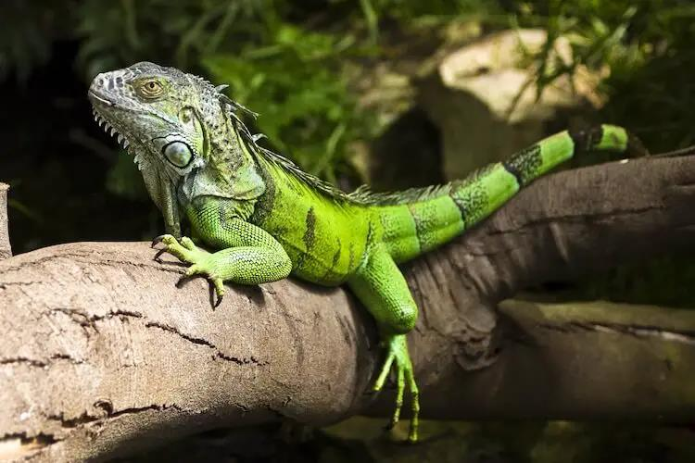

Slide 5
The Caiman Lizard (Dracaena guianensis) and the Tepui Lizard (Pristidactylus urichi) are captivating reptile species found in South America. The Caiman Lizard is semiaquatic, while the Tepui Lizard is adapted to life in isolated, highland plateaus. Both species are ecologically significant, and their unique characteristics make them stand out among other lizards. However, they face threats such as habitat destruction and illegal trade, emphasizing the need for conservation efforts to preserve them and their critical roles in their respective ecosystems.
The Caiman Lizard (Dracaena guianensis) is a captivating reptile native to the tropical regions of South America, particularly found in the Amazon Basin and its surrounding areas. The Tepui Lizard (Pristidactylus urichi) is a captivating and unique reptile inhabiting the Tepui plateaus of South America.

Slide 6
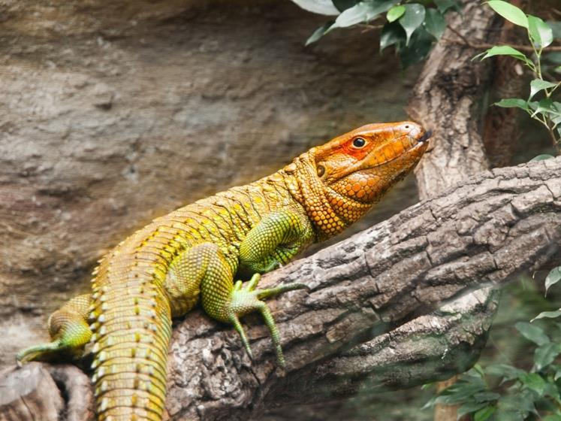

Slide 7
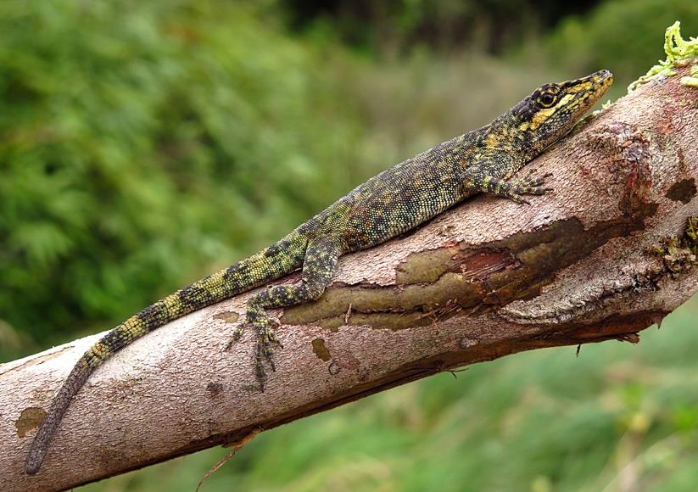

Slide 8
South America is home to an incredible diversity of lizard species, ranging from the mighty Green Iguana to the diminutive Tepui Lizard. This essay delves into the fascinating world of these captivating reptiles, exploring their unique characteristics, ecological roles, and threats they face. We'll discover how these lizards contribute to the overall balance and health of their ecosystems, from regulating insect populations to providing prey for other animals. We'll also learn about the threats they face, including habitat loss, illegal pet trade, and climate change, and explore how conservation efforts can help protect them. By the end, we'll have a deeper appreciation for the vital role these lizards play in South America's rich biodiversity.
South American lizards, such as the Green Iguana, Caiman Lizard, and Tepui Lizard, are fascinating creatures that contribute to the continent's rich biodiversity. This essay explores their unique characteristics, ecological roles, and threats they face, emphasizing the importance of conservation efforts to ensure their survival.

Slide 9
South American lizards are facing numerous threats, such as habitat loss, climate change, and illegal trade, which necessitate urgent conservation efforts. Through responsible research, education, and community involvement, we can work towards protecting the habitats and promoting the welfare of these reptilian inhabitants.
South America is home to an impressive diversity of lizards, ranging from small geckolike creatures to large monitor lizards. These reptiles play vital roles in their respective ecosystems, maintaining the delicate balance of the food chain. However, they are facing numerous threats, such as habitat loss, climate change, and illegal trade, which necessitate urgent conservation efforts.

